Slide 1
PEOPLE’ S COMMITTEE OF BINH CHANH DISTRICT
TAN NHUT 6 PRIMARY SCHOOL
WELCOME TO ENGLISH ONLINE LESSON

Slide 2
FAMILY AND FRIENDS Special Edition 4
Unit 1:THEY’RE FROM AUSTRALIA!
Lesson 2: Grammar
Teacher: Pham Thi Nam
Date: Monday, October 01st, 2021

Slide 4
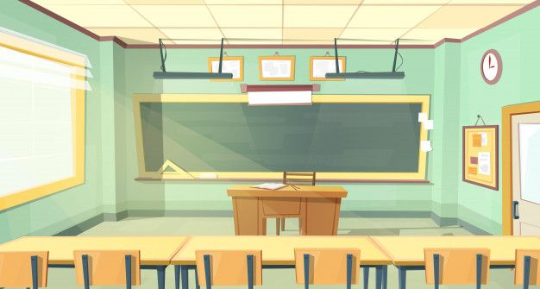
Where is she from?
A. She’s from Viet Nam.
B. She’s from Korea.

Slide 5
Where are they from?
A. they’re from Viet Nam.
B. We’re from Spain.

Slide 6
Where is he from?
A. She’s from Korea.
B. He’s from Mexico.

Slide 7
Where are they from?
A. They’re from the USA.
C. I’m from the USA.

Slide 8
1. Tom is nine. …. from the USA.
A. He’s
B. We’re
C. She’s
D. They’re

Slide 9
Question 2:Jenny is eight. …. from Australia.
A. We’re
B. She’s
C. He’s
D. They’re

Slide 10
3. Chi and I are friends. … from Viet Nam.
A. We’re
B. She’s
C. He’s
D. They’re

